Slide 1
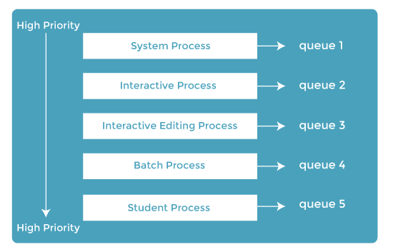
MULTILEVEL QUEUE SCHEDULING
ADVANTAGES:
More efficient algorithm as all queue can be handled efficiently
DISADVANTAGE:
Processes cannot move between queue
Process may go into starvation as they need to wait a lot

Slide 2
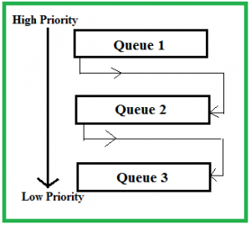
MULTILEVEL FEEDBACK QUEUE SCHEDULING

Slide 3
ALGORITHM EVALUATION
The first thing we need to decide is how we will evaluate the algorithms. To do this we need to decide on the relative importance of the factors we listed above (Fairness, Efficiency, Response Times, Turnaround and Throughput). Only once we have decided on our evaluation method can we carry out the evaluation.
There are 3 Evaluation Methods which can be used for selection of an algorithm
1)Deterministic modelling
2)Queuing model
3)Simulation

Slide 4
Deterministic modeling
This evaluation method takes a predetermined workload and evaluates each algorithm using that workload.
Process | Burst Time
P1 | 9
P2 | 33
P3 | 2
P4 | 5
P5 | 14
We need to find average waiting time of all the algorithm and whichever provides minimum waiting time that algorithm will be best to achieve our goal.
Advantage:simple,fast and easy to compute
Disadvantage:It requires exact knowledge of system workload

Slide 5
Queuing Model:
In this we assume that every resource of computer will act as server and every server will have its own queue.
Knowing the arrival rate and service rate we can calculate cpu utilization, average waiting time, average queue length.
We uses littles formula
N=ꭚw
Where N is average queue length
ꭚ is average arrival rate of process
W is average waiting time

Slide 6
SIMULATION
To get more accurate evaluation of algorithm we use simulation .
We develop a programming model through which we can check the various parameters for all scheduling algorithm.
Data collected from real processes on real machines and is fed into the simulation. This can often provide good results and good comparisons over a range of scheduling algorithms.

Slide 7
Multiple processor scheduling
In multiple-processor scheduling multiple CPU’s are available and hence Load Sharing becomes possible. However multiple processor scheduling is more complex as compared to single processor scheduling.
Multiple-processor scheduling is important because it enables a computer system to perform multiple tasks simultaneously, which can greatly improve overall system performance and efficiency.
Multiple-processor scheduling works by dividing tasks among multiple processors in a computer system, which allows tasks to be processed simultaneously and reduces the overall time needed to complete them.

Slide 8
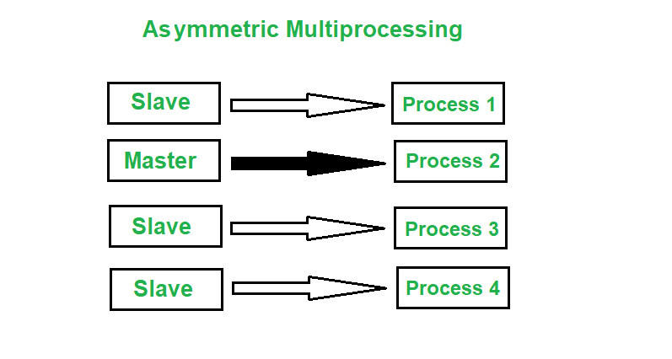
ASYMMETRIC MULTIPROCESSING
Asymmetric Multiprocessing system is a multiprocessor computer system where not all of the multiple interconnected central processing units (CPUs) are treated equally. In asymmetric multiprocessing, only a master processor runs the tasks of the operating system.
The processors in this instance are in a master-slave relationship. While the other processors are viewed as slave processors, one serves as the master or supervisor process.
In this system, the master processor is responsible for assigning tasks to the slave processor.

Slide 9
SYMMETRIC MULTIPROCESSING
1)Global Queue
2)Local queue
3)Hybrid Approach

Slide 10
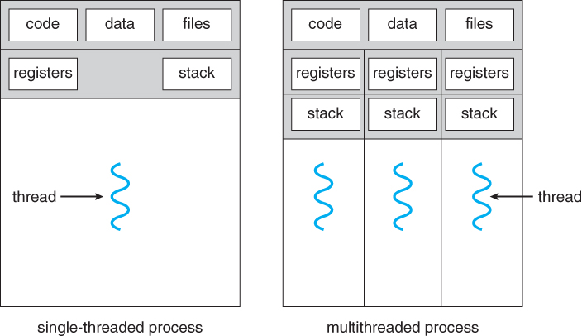
THREADS
Thread is a part of execution of a process.
A process can contain multiple threads.
If a process has multiple threads that means it can perform multiple task at a time

Slide 11
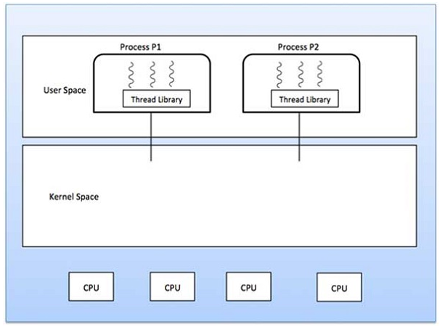
TYPES OF THREAD
USER LEVEL THREAD
KERNEL LEVEL THREAD

Slide 12
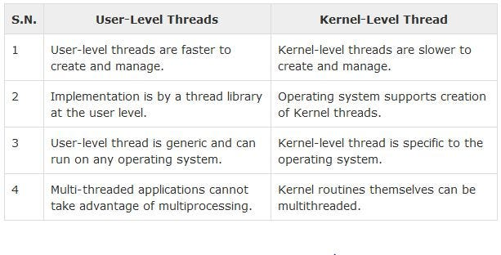
CONT….

Slide 13
MEMORY ALLOCATION METHODS
CONTIGOUS- 1)SINGLE PARTITION –does not support multiprogramming
2)MULTIPLE PARTITION - a)Fixed partition(MFT)
b)Variable partition(MVT)
Non Contigous -1)Paging
2)Segmentation
3)Paging with segmentation

Slide 14
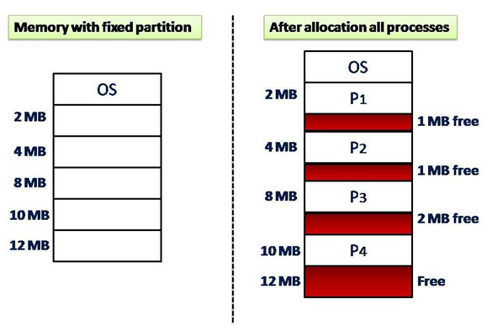
MFT/fixed partition
In this partition,number of partitions in RAM are fixed but size of each partition may vary.

Slide 15
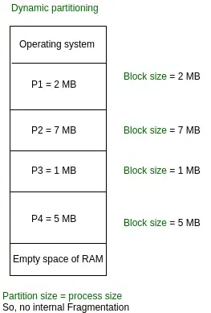
MVT/variable partition

Slide 16
Partition Allocation Methods
First fit
Best fit
Worst Fit
Q) Given 5 memory partitions of 100KB,500KB,200KB,300KB,600KB.
How would each of first fit,best fit ,worst fit and next fit algorithm places processes of 212kb,417kb,122kb,426kb in order.Which algorithm is best and waste less memory space.

Slide 17
Non contiguous memory allocation- PAGING
Swapping Concept:::

Slide 18
PAGING
In paging,memory is divided into no of blocks of fixed size called frames
Each process is divided into no of fixed size called pages
Size of page = size of frame
PAGE 1
PAGE 2
PAGE 3
PAGE 4
PAGE 1
PAGE 3
PAGE 2
PAGE 4
FRAME 0
FRAME 1
FRAME 2
FRAME 3
FRAME 0
PAGE 1
PAGE 2
FRAME 1

Slide 19
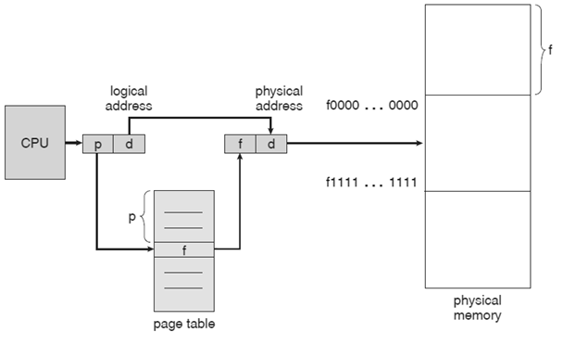
GENERATION OF PHYSICAL ADDRESS

Slide 20
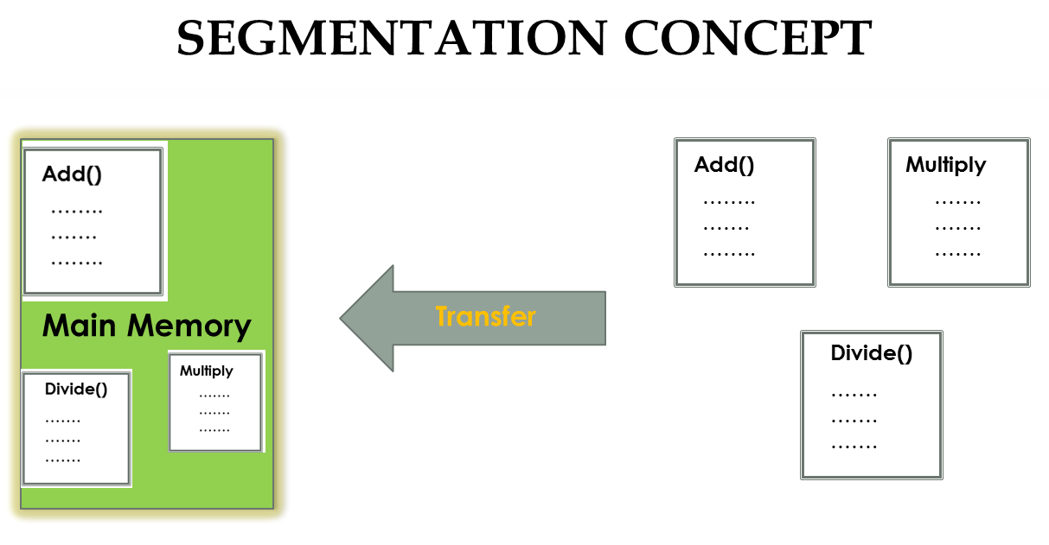

Slide 21
Segment 1
Base address of segment
Size of segment
Segment 2
Segment 3
Segment 4

Slide 22
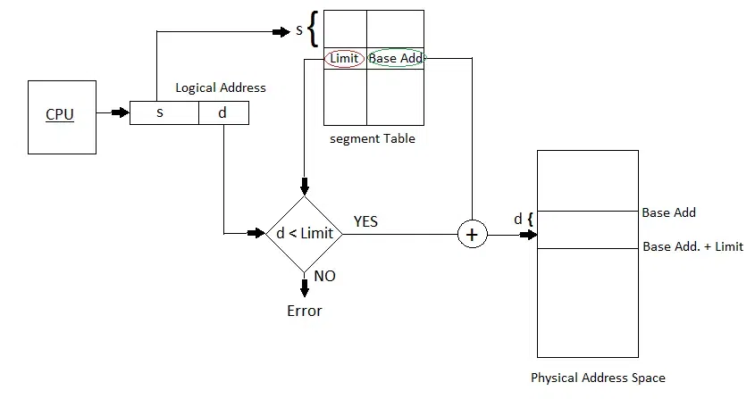
Generation of physical Address
S is segment no
D is offset with segment
B is base address of segment
Z is size of segment

Slide 23
Paging with segmentation
It combines features of both paging and segmentation
Each segment is divided into pages of fixed size which is equal to main memory frames.
Each segment has page table
2 Tables are used –segment and page table
Logical address consists of segment no and segment offset
Segment offset is divided into 2 parts
Page number and page offset

Slide 24
